Slide 1
Computational Thinking & Systems Design Lecture 13 Operating System: Memory Management and Graphics
Ben Koo
December 8, 2020

Slide 2
The Jack OS
Math: Provides basic mathematical operations;
String: Implements the String type and string-related operations;
Array: Implements the Array type and array-related operations;
Output: Handles text output to the screen;
Screen: Handles graphic output to the screen;
Keyboard: Handles user input from the keyboard;
Memory: Handles memory operations;
Sys: Provides some execution-related services.

Slide 3
A typical OS:
Is modular and scalable
Empowers programmers (language extensions)
Empowers users (file system, GUI, ...)
Closes gaps between software and hardware
Runs in “protected mode”
Typically written in some high level language
Typically grows gradually, assuming more and more functions
Must be efficient.

Slide 4
Success Criteria
Running Time Analysis (Performance/Efficiency)
Resource Allocation
Input Handling
Vector Graphics
Textual Outputs
Type Conversions
String Processing
.

Slide 5
Jack OS recap
Project 12:
Build it.
class Math {
function void init()
function int abs(int x)
Class String {
Class Array {
function Array new(int size)
method void dispose()
}
class Output {
Class Screen {
class Memory {
function int peek(int address)
Class Keyboard {
Class Sys {
function void halt():
function void error(int errorCode)
function void wait(int duration)
}
Implementation: just like GNU Unix and Linux were built:
Start with an existing system, and gradually replace it with a new system, one library at a time.

Slide 6
Perspective
What we presented can be described as a:
mini OS
Standard library
Many classical OS functions are missing
No separation between user mode and OS mode
Some algorithms (e.g. multiplication and division) are standard
Other algorithms (e.g. line- and circle-drawing) can be accelerated with special hardware
And, by the way, we’ve just finished building the computer.

Slide 7
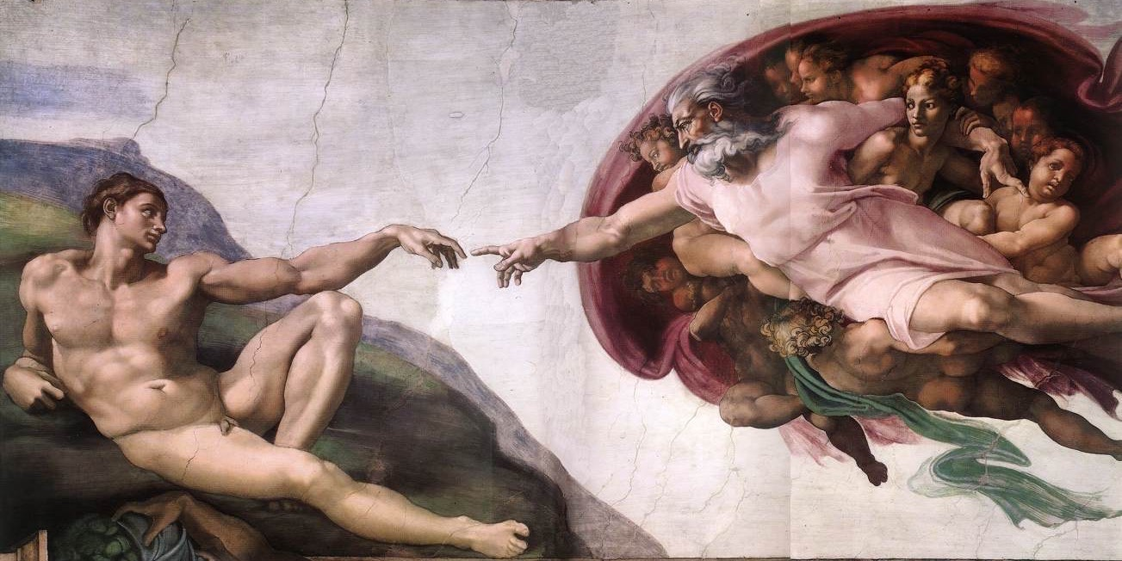
Here’s Nand; Go build a computer
Nand
In CS, God gave us Nand
Everything else was done by humans.

Slide 8
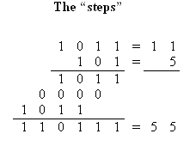
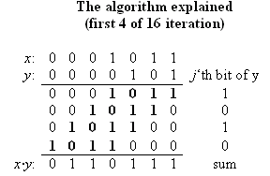
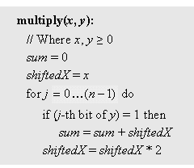

Example I: multiplication
Run-time: proportional to n
Can be implemented in SW or HW
Division: similar idea.

Slide 9
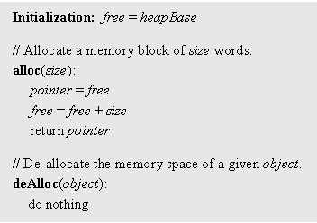
Memory management (naive)
When a program constructs (destructs) an object, the OS has to allocate (de-allocate) a RAM block on the heap:
alloc(size): returns a reference to a free RAM block of size size
deAlloc(object): recycles the RAM block that object refers to
The data structure that this algorithm manages is a single pointer: free.

Slide 10
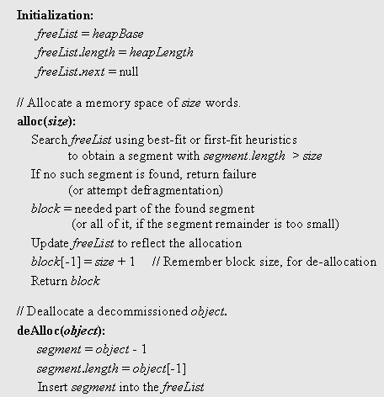
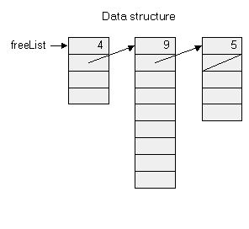
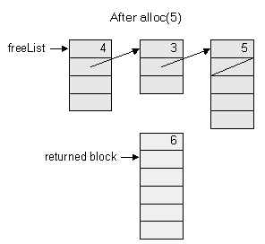
Memory management (improved)

Slide 11
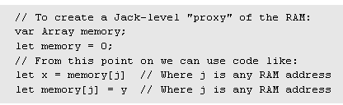
Peek and poke
class Memory {
function int peek(int address)
function void poke(int address, int value)
function Array alloc(int size)
function void deAlloc(Array o)
}
Implementation: based on our ability to exploit exotic casting in Jack:

Slide 12
Graphics primitives (in the Jack OS)
class Math {
class String {
class Array {
class Output {
class Screen {
class Memory {
class Keyboard {
class Sys {
function (…)
…
}
Class Screen {
function void clearScreen()
function void setColor(boolean b)
function void drawPixel(int x, int y)
function void drawLine(int x1, int y1, int x2, int y2)
function void drawRectangle(int x1, int y1,int x2, int y2)
function void drawCircle(int x, int y, int r)
}

Slide 13
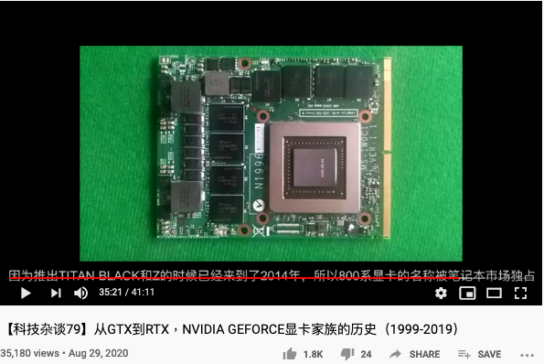
A History of Graphics Acceleration Hardware
https://youtu.be/UUxUCVlXV0A

Slide 14
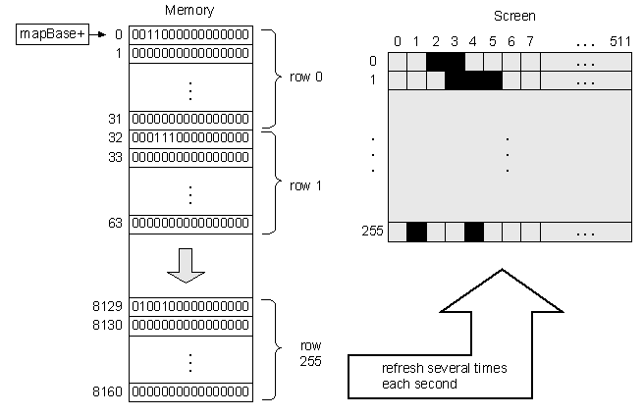
Memory-mapped screen

Slide 15
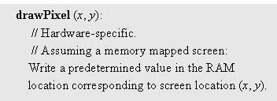
Pixel drawing
Implementation: using poke(address,value)

Slide 16
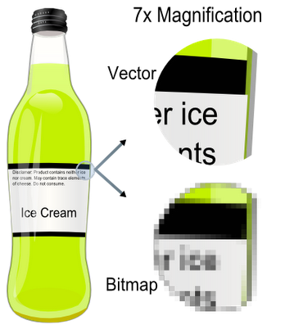
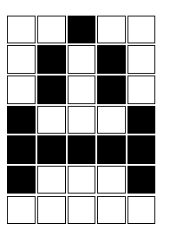
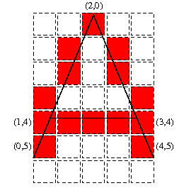
Image representation: bitmap versus vector graphics
pixel
(0,0)
bitmap
vector
Bitmap file: 00100, 01010,01010,10001,11111,10001,00000, . . .
Vector graphics file: drawLine(2,0,0,5), drawLine(2,0,4,5), drawLine(1,4,3,4)
Pros and cons of each method.
Notes:
16

Slide 17

Vector graphics: basic operations
0
1
2
3
.
.
.
drawPixel(x,y)
(Primitive operation)
0
1
drawLine(x1,y1,x2,y2)
2
3
Screen =
grid of pixels
drawCircle(x,y,r)
.
.
drawRectangle(x1,y1,x2,y2)
.
drawTriangle(x1,y1,x2,y2,x3,y3)
etc. (a few more similar operations)
0
1
2
3
4
5
6
7
8
9
10
11
12
13
0
1
drawLine(0,3,0,11)
drawRectangle(1,3,5,9)
drawLine(1,12,2,12)
drawLine(3,10,3,11)
drawLine(6,4,6,9)
drawLine(7,0,7,12)
drawLine(8,1,8,12)
2
3
4
5
6
7
8
9
Notes:
17

Slide 18

How to draw a line?
drawLine(x1,y1,x2,y2)
Basic idea: drawLine is implemented through a sequence of drawPixel operations
Challenge 1: which pixels should be drawn ?
Challenge 2: how to draw the line fast ?
Simplifying assumption: the line that we are asked to draw goes north-east.
Notes:
18

Slide 19
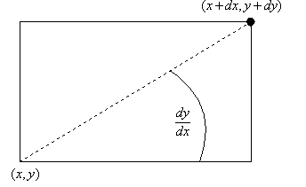
Line Drawing
Given: drawLine(x1,y1,x2,y2)
Notation: x=x1, y=y1, dx=x2-x1, dy=y2-y1
Using the new notation: We are asked to draw a line between (x,y) and (x+dx,y+dy)
dy
dx
set (a,b) = (0,0)
while there is more work to do
drawPixel(x+a,y+b)
decide if you want to go right, or up
if you decide to go right, set a=a+1; if you decide to go up, set b=b+1
set (a,b) = (0,0)
while (a ≤ dx) and (b ≤ dy)
drawPixel(x+a,y+b)
decide if you want to go right, or up
if you decide to go right, set a=a+1; if you decide to go up, set b=b+1
Notes:
19

Slide 20
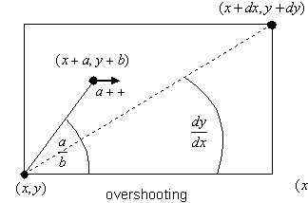
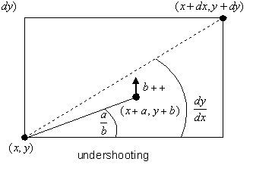
Line Drawing algorithm
drawLine(x,y,x+dx,y+dy)
set (a,b) = (0,0)
while (a ≤ dx) and (b ≤ dy)
drawPixel(x+a,y+b)
decide if you want to go right, or up
if you decide to go right, set a=a+1; if you decide to go up, set b=b+1
drawLine(x,y,x+dx,y+dy)
set (a,b) = (0,0)
while (a ≤ dx) and (b ≤ dy)
drawPixel(x+a,y+b)
if b/a > dy/dx set a=a+1 else set b=b+1
Oy Vey
Notes:
20

Slide 21
Line Drawing algorithm, optimized
Motivation
When you draw polygons, e.g. in animation or video, you need to draw millions of lines
Therefore, drawLine must be ultra fast
Division is a very slow operation
Addition is ultra fast (hardware based)
drawLine(x,y,x+dx,y+dy)
set (a,b) = (0,0)
while (a ≤ dx) and (b ≤ dy)
drawPixel(x+a,y+b)
if b/a > dy/dx set a=a+1 else set b=b+1
b/a > dy/dx is the same as a*dy < b*dx
Define diff = a*dy – b*dx
Let’s take a close look at this diff:
b/a > dy/dx is the same as diff < 0
When we set (a,b)=(0,0), diff = 0
When we set a=a+1, diff goes up by dy
When we set b=b+1, diff goes down by dx
drawLine(x,y,x+dx,y+dy)
set (a,b) = (0,0), diff = 0
while (a ≤ dx) and (b ≤ dy)
drawPixel(x+a,y+b)
if diff < 0 set a=a+1, diff = diff + dx else set b=b+1, diff = diff - dy
Notes:
21

Slide 22
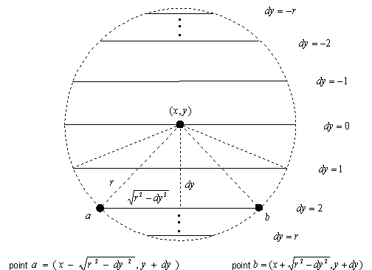
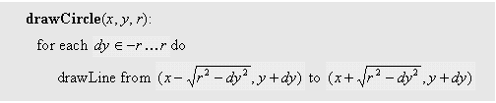
Circle drawing
The screen origin (0,0) is at the top left.

Slide 23
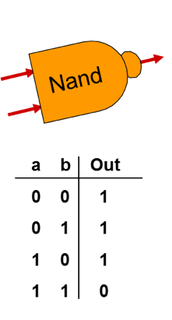
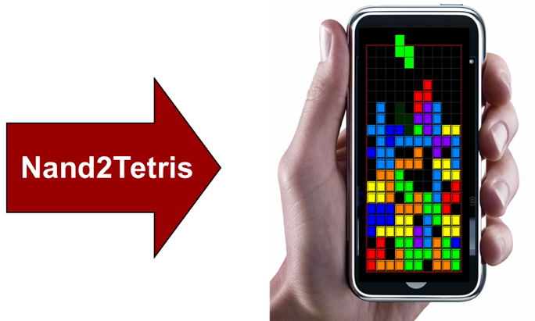
Some Final notes
CS is a science
What is science?
Reductionism
Life science: From Aristo (millions of rules) to Darwin (3 rules) to Watson and Crick (1 rule)
Computer science: We knew in advance that we could build a computer from almost nothing. In this course we actually did it.
Key lessons:
Elegance
Clarity
Simplicity
Playfulness.

Slide 24

What if a Unifying Foundation doesn’t exist?
What if there are many Cognitive Foundations?
For example： What if
We might assume that humans and aliens have significantly different cognitive frameworks.
But, are the fundamentally different?
Can there be any “connections”?
b/a > dy/dx is the NOT same as a*dy < b*dx
Define diff = a*dy – b*dx
Let’s take a close look at this diff:
b/a > dy/dx is the same as diff < 0
When we set (a,b)=(0,0), diff = 0
When we set a=a+1, diff goes up by dy
When we set b=b+1, diff goes down by dx
It is like admitting there exists some completely exotic species…

Slide 25
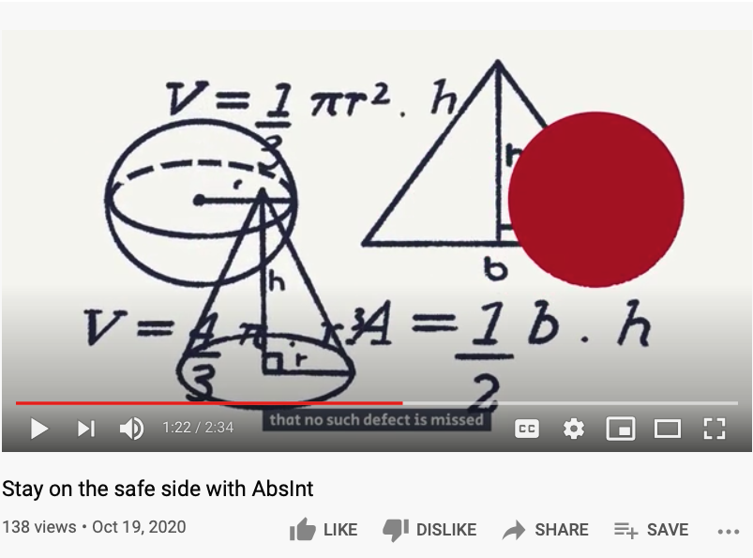
A Sound Foundation for Computational Tools?
A commercial by a German company
The website of absint.com stated: “Safety standards like ISO 26262, DO-178B, DO-178C, IEC-61508, and EN-50128 require identifying functional and non-functional hazards and demonstrating that the soft­ware does not violate the rele­vant safety goals.”

Slide 26
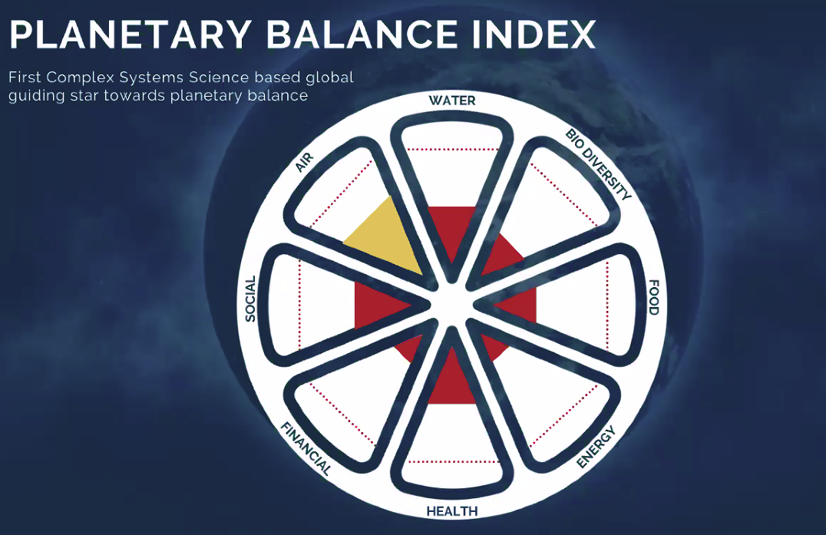
What I learned this weekend?
A possible candidate for “Enlightened” metrics

Slide 27
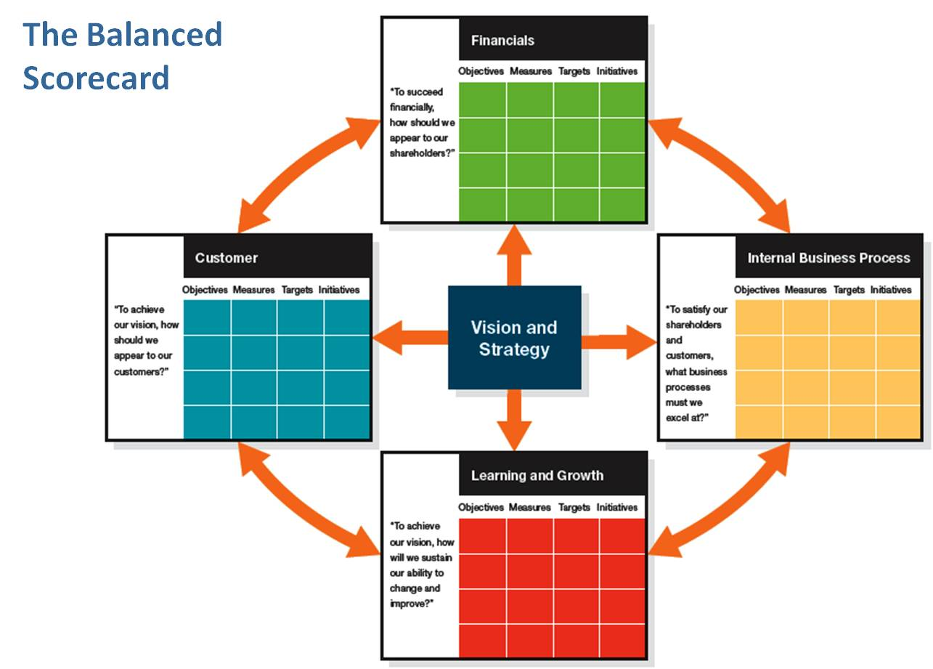
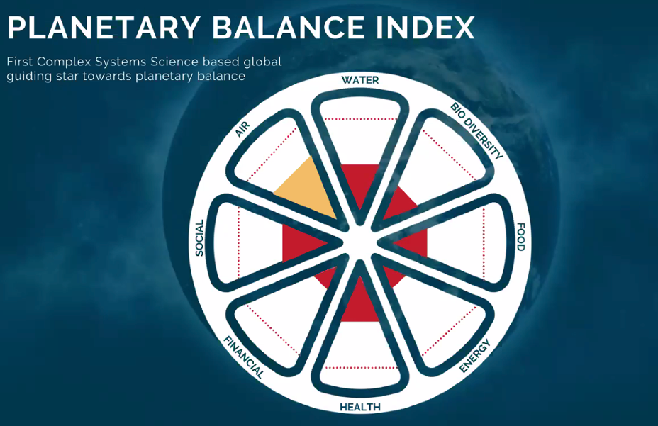
What makes a metric system “sound and complete”?
The BSC pioneered by
Robert Kaplan and David Norton
How to know whether this metric system
Is or Isn’t Sound and Complete?
Image source: by Suleiman Shehu

Slide 28
Mapping from 8 to 4 measurement components
How to know whether this metric system
Is or Isn’t Sound and Complete?
Image source: by Suleiman Shehu

Slide 29

Color code and rearrange the “Balanced Index”
Energy
(Initial Object)
Financial
Food
Air
Health
Water
Internal Social
External Social
Bio Diversity
(Terminal Object)
Learning and Growth

Slide 30
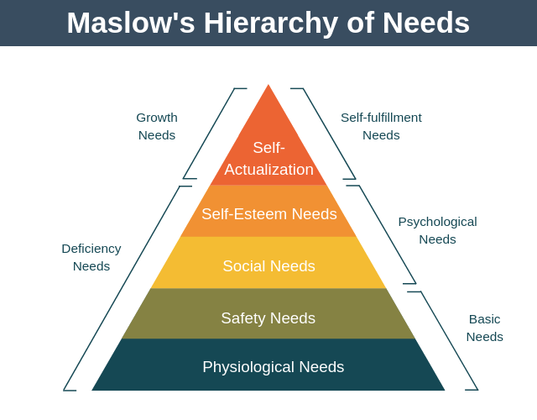
What kind of Data Structures fit these patterns?
Bio Diversity
(Terminal Object)
Terminal Object
Internal Social
External Social
Air
Health
Water
Food
Financial
Energy
(Initial Object)
Initial Object

Slide 31
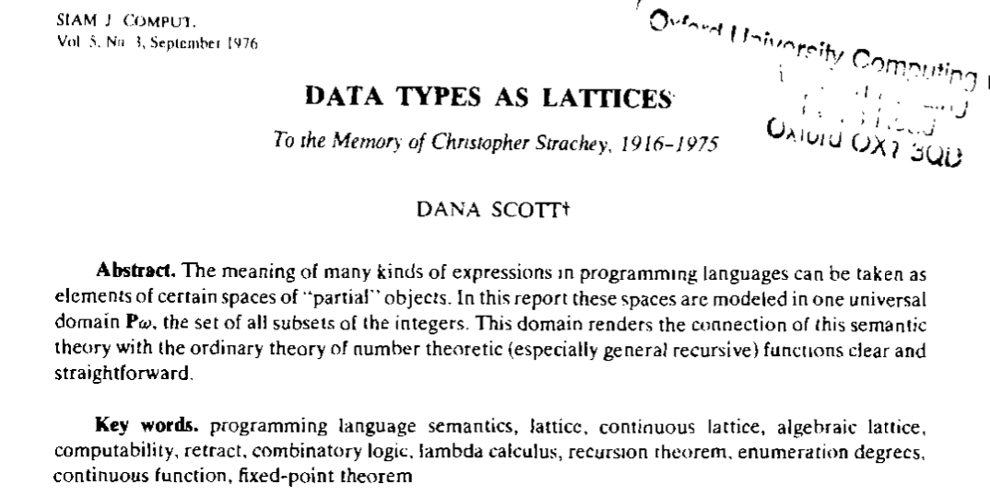
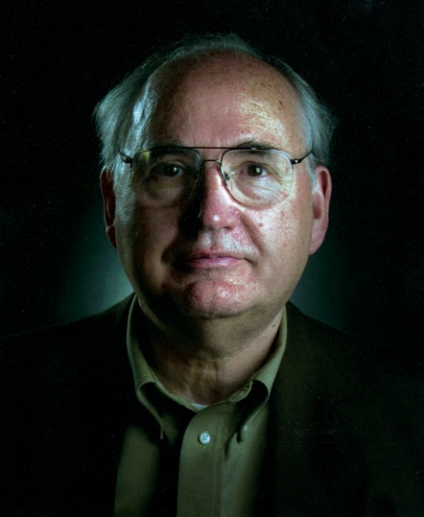
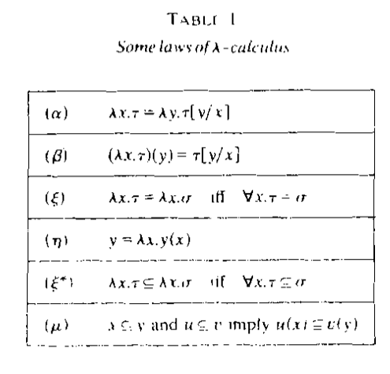
All meaningful expressions can be modeled as $𝒫ω$
Prof. Dana Stewart Scott
Image Source: Britannica

Slide 32
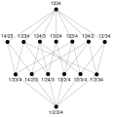
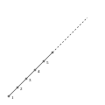
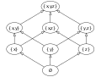
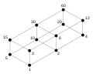
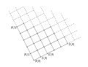
What is a Lattice?
Pic. 1: Subsets of {x, y, z}, under set inclusion. The name "lattice" is suggested by the form of the Hasse diagram depicting it.
Pic. 2: Lattice of integer divisors of 60, ordered by "divides".
Pic. 3: Lattice of partitions of {1, 2, 3, 4}, ordered by "refines".
Pic. 4: Lattice of positive integers, ordered by ≤.
Pic. 5: Lattice of nonnegative integer pairs, ordered component wise.
Source of Images and Text : https://en.wikipedia.org/wiki/Lattice_(order)

Slide 33
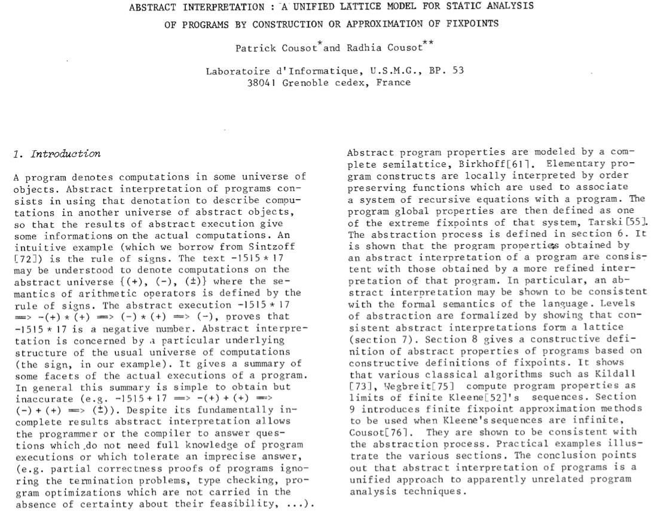
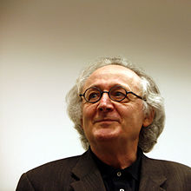
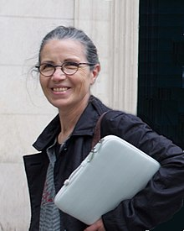
Lattice represents a Universal Data Type
Patrick Cousot
Radhia Cousot
Source of Text : https://www.di.ens.fr/~cousot/publications.www/CousotCousot-POPL-77-ACM-p238--252-1977.pdf

Slide 34
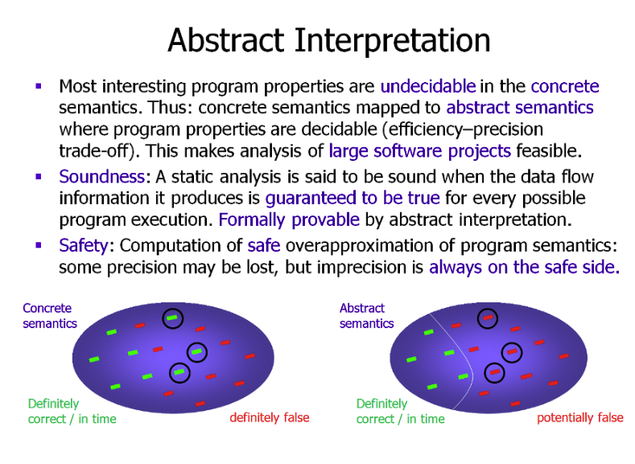
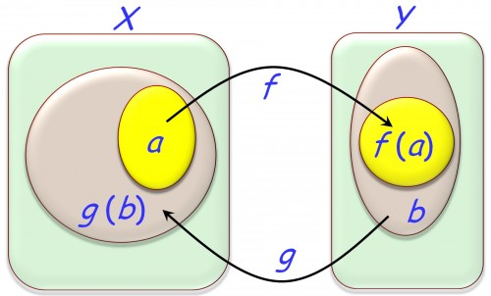
The Abstract and Concrete Domains
You may think of different colors represent different “intervals”. Where intervals are representable as bounded regions mathematically modeled as Lattices or Posets..

Slide 35
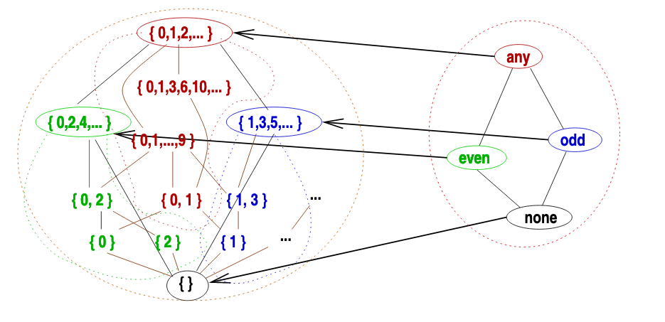
All Computation (decisions) are approximations
A lattice (L, ⊑, ⊥, ⊔, ⊤, ⊓) is a partially ordered set (L, ⊑) with:
Least upper bounds (⊔) and greatest lower bounds (⊔) operators
A least element “bottom”: ⊥
A greatest element “top”: ⊤
L is complete if all least upper bounds exist
A fixpoint X of F: L → L satisfies F(X) = X
We denote by lfp F the least fixpoint if it exists

Slide 36

Fixpoint Theorems/Mathematical Ouroboros
Knaster-Tarski theorem: If F: L → L is monotone and L is a complete lattice, the set of fixpoints of F is also a complete lattice.
Kleene theorem: If F: L → L is monotone, L is a complete lattice and F preserves all least upper bounds then lfp F is the limit of the sequence:
F₀ = ⊥
F_{n+1} = F (F_{n})

Slide 37
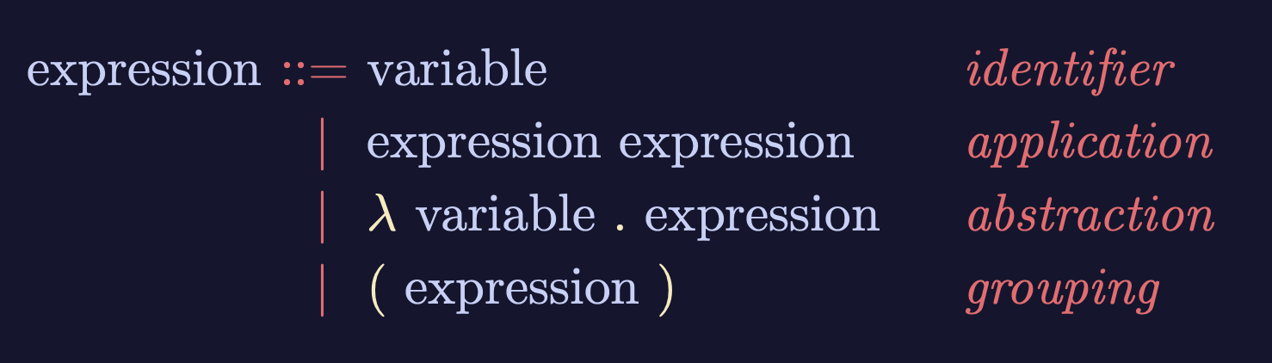
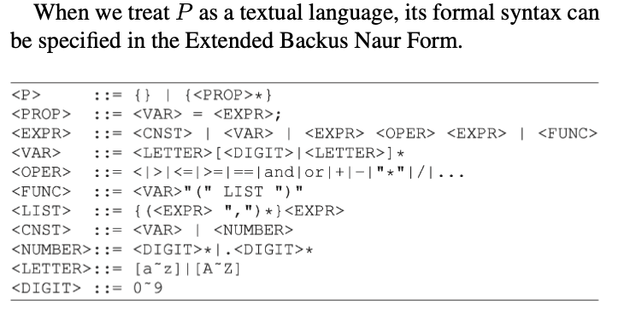
Lambda-Calculus is an Ouroboros
Variable
Expression1
Expression2
𝜆
Variable
Expression
( )
Expression
Lambda calculus as an executable rewrite process is a Lattice/Poset.
Paradigm shifting concepts
and
incommensurable terms
Normal Science
Model
Drift
Model Crisis
Model Revolution
Paradigm
Change
Learning as a vocabulary acquisition process!
Backus-Naur Form provides a way to customize the “concrete syntax” of formal languages.

Slide 38

Ouroboros connects the beginning with the end
Lambda Calculus are composed of Expressions,
and
Expressions are composed of other expressions…
Variable
Expression1
Expression2
𝜆
Variable
Expression
( )
Expression
Lambda calculus as an executable rewrite process is a Lattice/Poset.
Early alchemical ouroboros illustration with the words ἓν τὸ πᾶν ("The All is One") from the work of Cleopatra the Alchemist in MS Marciana gr. Z. 299. (10th Century)
Image and Text: Wikipedia

Slide 39
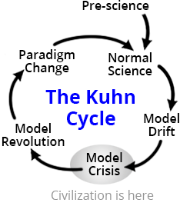
Recursion/Iteration:
connects the beginning with the end
Lambda Calculus are composed of Expressions,
and
Expressions are composed of other expressions…
Variable
Expression1
Expression2
𝜆
Variable
Expression
( )
Expression
Lambda calculus as an executable rewrite process is a Lattice/Poset.

Slide 40
Recursion/Iteration:
connects the beginning with the end
Every KIND of Lambda Expression is a Type,
and
a small number of Types can be Computationally Complete…
a
Variable
b
Expression1
Expression2
c
𝜆
Variable
Expression
( )
d
Expression
e (empty type)

Slide 41
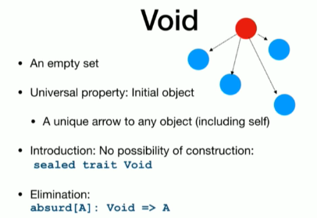
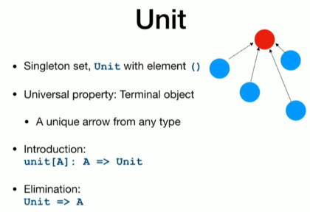
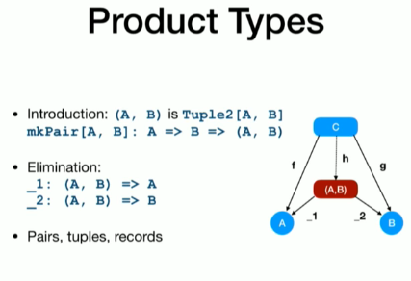
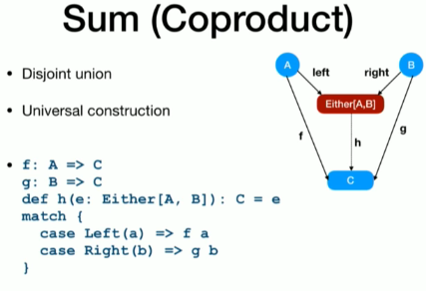
A few screen shot for basic data types?
Variable
Expression1
Expression2
𝜆
Variable
Expression
( )
Expression

Slide 42
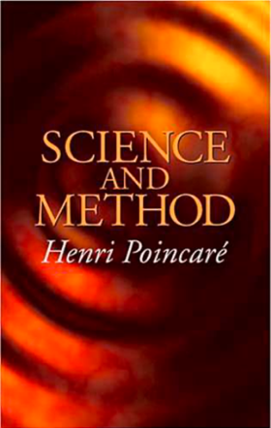

Types in Name Space Management
Every KIND of Lambda Expression is a Type,
and
a small number of Types can be Computationally Complete…
a
Variable
b
Expression1
Expression2
c
𝜆
Variable
Expression
( )
d
Expression
e (empty type)

Slide 43

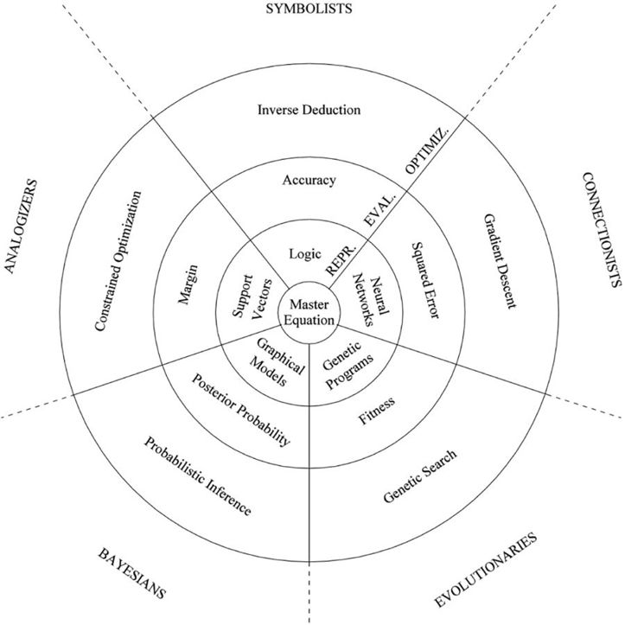



The Allegory of the Master Algorithm
（寓言）
The Allegory of a Smart City made of 3 concentric circles and occupied by 5 tribes:
Circles:
Optimization (Search)
Evaluation (Assessment and Rewrite)
Representation (NsM)
Practical Concerns:
Optimization (Search)
Scalability
Evaluation (Assessment and Rewrite)
Correctness
Representation (NsM)
Sound/Complete
Master
Equation
Chinese Translation
Image Source: P. 240 of The Master Algorithm
43

Slide 44






The Leaders of the Five Tribes
Image Source: P. 240 of The Master Algorithm
44

Slide 45













An integrated (ethical) architecture
to implement the Master Algorithm
Software
Hardware
Scientific “Evolution”
Neutral Network
Symbolic Logic
Causal Probability
Conceptual Analogies
T. Kuhn
Content
IoT and Quantum Computing
TPU
GPU
CPU
Big Data
Computed Data
Artificial Data
Resource
Standard
J. Hinton
Distributed
Centralized
General Protocol
S. Wolfram
J. Pearl
Governance Strategies
Collective learning systems
Data Assets, Structures
Extreme Learning Process
G. Lakoff
Computing Architectures, Instrumentation
Encoding strategy, Ontology, Epistemology

Slide 46


Accountants’ Ouroboros
The International
Integrated Reporting
Framework
Dec. 2013
Notes:
“historian James Aho linked double-entry bookkeeping to the ancient art of rhetoric,”
Excerpt From: Jane Gleeson-White. “Double Entry.” Apple Books.

Slide 47

A Quick Review of Universal Objects in Category Theory
https://youtu.be/iJ7V1KXJpsE?t=1116

Slide 48


The Three Stages of the Cognitive Ladder
Why/Counterfactuals
Learning comes from What if assumptions…
How/Intervention
perform action under “Free” will
What/Association
the common observables

Slide 49
How big is the size of What If possibilities?
How/Intervention (a methodical way to intervene complexity)
Most of the operational what-if possibility spaces are rather small, so that people can deal with them with their “natural” talents…
Big Data (Software Industry) and AI brings complexity to an operational level, small code changes could result in major consequences in software controlled systems, which is almost everything we deal with on daily basis …
How to keep Abstraction separated from Concretization?
The Cognitive Discipline wrapped around in: Namespace Management (NsM).
What if complexity becomes overwhelming? Recursively apply NsM!

Slide 50



What foundation is universally trust-worthy?
What/Association (a unitary foundation)
Is there a generic data type/algebraic structure that is applicable to all?
Poset/Lattice/Monad (the foundational abstract data type) has concrete specification, and can be stored, and manipulated using scalable computing devices …
The ”Associations” in Partially Ordered Set: Adjacent Possibilities (Stuart Kauffman)
Wikipedia: Veil of Ignorance

Slide 51





A Unifying Formula by Stuart Kauffman
The Theory of the Adjacent Possible
$$M_{t+1}=M_{t}+\sum_{i=1}^{M_{t}}{α_{i}\left({M_{t} \atop i}\right)}$$
Complexity Coherence Conference 2020
Stuartt Kauffman is an American medical doctor, theoretical biologist, and complex systemsresearcher who studies the origin of life on Earth. - wikipedia

Slide 52
What is the idea of Nature?
The Chinese phrase for Nature is: 自然！
Huawei VP Mr. Yang Shaoqing
The notion of “self” is related to the notion of
Identity morphism in Category Theory
Where the highest order of morphisms is called:
Natural Transformation

Slide 53


What is a “Self” ?
Is there a finite set of actions to verify the existence of self?
Is there a “universal grammar” that is applicable to all?
https://www.openculture.com/2019/02/a-brief-animated-introduction-to-noam-chomskys-linguistic-theory-narrated-by-the-x-files-gillian-anderson.html

Slide 54

What if a there is a secrete way to attain cognitive Universality?
It is like admitting there exists some completely exotic species…

Slide 55
Why Category Theory for Cognitive Foundation?
It is the smallest yet universal representation of concepts, so that it will fit into operational contexts when needed…

Slide 56

The Algebraic features of Data Types
Huawei VP Mr. Yang Shaoqing
https://youtu.be/LkqTLJK2API?t=3126

Slide 57


The Algebraic features of Data Types
Huawei VP Mr. Yang Shaoqing
https://youtu.be/YScIPA8RbVE?t=2040
https://youtu.be/YScIPA8RbVE?t=1986

Slide 58



The Polynomial trick also appears in Fast Fourier Transform
Huawei VP Mr. Yang Shaoqing
https://youtu.be/h7apO7q16V0?t=732

Slide 59


The Fundamental Theorem of Algebra
Huawei VP Mr. Yang Shaoqing
https://youtu.be/d8-LO6FCna0?t=65
https://youtu.be/shEk8sz1oOw?t=110
Fundamental theorem of algebra | Khan Academy
Fundamental Theorem of Algebra - Numberphile

Slide 60

The Fundamental Theorem of Arithmetic (Name Space Management Trick)
Huawei VP Mr. Yang Shaoqing
https://youtu.be/8CluknrLeys?t=225
The fundamental theorem of arithmetic | Computer Science | Khan Academy

Slide 61


When explaining the idea of Universal Properties …
We have explained certain aspects of all other properties in the ring.
Huawei VP Mr. Yang Shaoqing

Slide 62


Stream as a Data Type is called the Universal Element
Huawei VP Mr. Yang Shaoqing
https://youtu.be/9u1q3lH7VbE?t=1205（explaination starts at 20:05）

Slide 63
We live in a Smart World,
Driven by Physically Meaningful Data
Image credits: http://verses.io

Slide 64

Operationalizing the Cybernetics
How to deploy a Kubernetes Cluster from Scratch (Youtube Link)

